Slide 1


PassionMaster
E-Learning Platform
Done By
M.Dharshini
V.Brindha
III CSE A

Slide 2

Problem statement
Rural education condition in India has been still improving. However,rural schools have to face a lot of suffering.
There are not enough classrooms,teachers & other educational facilities.
There are lots of resources available on internet but it costs a lot of time to get what they need.
Innovation in Technology enabled cost-effective output-oriented learning in Rural India benefits them a lot.

Slide 3

Proposed Solution:
Solution Overview 1
Solution Overview 2
Solution Overview 3
A website is created with all the learning facilities which includes features like AI based Voice assistant , E-books for reference,Virtual labs to do experiments, Online Exams to track the students performance ,Ranking system and Attendance management system also will be provided.
In addition to this 24 hours live online support is also provided to clarify the students doubts,Weekly once motivational live classes to make students interactive. This technology is free of cost which will be very useful for rural areas people to enhance the quality of education.
Using Artificial Intelligence we can track the students' performance and make recommendation system to recommend the students more notes related to the subjects in which they got less marks.With Data Analytics we can set the goal to make students score high marks.

Slide 4

ABSTRACT:
Nowadays everyone is aware of using technology like mobile phones, laptops, tablets,etc.
Development in technology has benefited a lot of people.
In rural areas many people are facing struggles in the education facilities.
To overcome these issues we have introduced the idea of an E-Learning platform with 24 hours live support features. This results in cost effective learning.
We proposed the idea of creating a website in which users could learn everything as per government issued syllabus and the voice assistant is also provided to explain the content present inside their academics.
Online E- books are also present which will help to learn in a detailed manner.
In addition to this, doing exams in online options along with a ranking system according to class vice is also provided.

Slide 5

Novelty of The Project
- Desirability, Viability, Usability and Tech Feasibility

Slide 6

This website identifies both learning students and not learning students.
Using Clustering techniques we can classify the students according to their scores and recommend the relevant study material to concentrate more on that subject in which students got low marks.
Using the attendance system we were able to track students' performance easily.
To upskill the knowledge Daily assessments will be auto posted in websites according to their classes using AI.
Using Data Analytics we could easily visualize the overall performance of students ,their attendance and also their marks obtained which helps to improve the students score in future exams.
By making use of online tools & virtual labs students are able to learn more as per their own convenience with the sources that they have.

Slide 7

Desirability from target users:
Innovative Technology like creating E-Learning platforms promotes increased success.
About 37% students in rural areas can score up to Higher when they are provided with technology resources .
The majority of jobs require technological skills.
Digital literacy provides more ability to access digital resources and gain more knowledge from it.
This educational software makes students succeed in their career easily with the help of technology.
This open source cost effective technology creates a great social impact in education facilities for students in rural areas.

Slide 8

Economic Benefits:
This E-Learning platform will benefit both students & Staff from all over India.
Since this is open source platform student can make use of it free.
For Staff’s we can provide revenue through the advertisement .

Slide 9
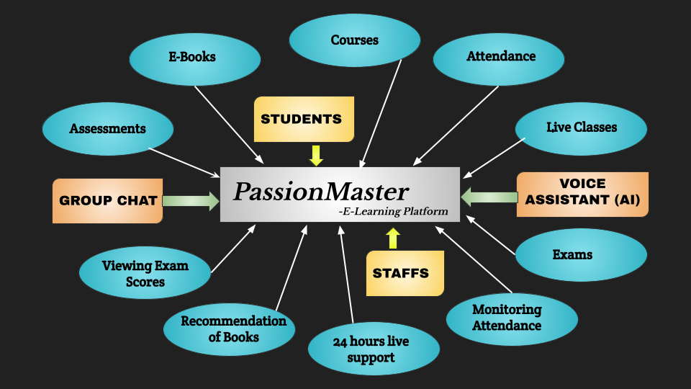

Slide 10

Literature Review :
Review 1
Review 2
Overall Literacy rate of India in 2021 is
74.04%.
Male:82.14%
Female:65.46%
Literacy rate of rural area India in 2021 is 73.5%.
Male: 78.57%
Female: 58.75%

Slide 11
Results Analysis
9.5 Million
65.5%
1,391.99 Million
48%
Are rural people in India
E-book readers in online
Of people will benefit from E-learning Platform
Total population of in India in 2021

Slide 12

Why might chosen solution fails?
This E-Learning platform faces challenges like lack of in-person interaction.
To overcome this we proposed the idea of implementing a Group chat option in the website in which students would be able to interact with each other.
Another challenge also students are facing like students require some relaxation ,motivation,and entertaining classes.
To rectify this issue weekly once live online motivation classes will be implemented to boost up the students motivation in learning.

Slide 13

Metrics for Success:
Course review
Assessments Results
User Satisfaction
Learning Performance
Instructors Ratings

Slide 14

Thank You!
You only have to know one thing,
YOU CAN LEARN ANYTHING..

